Slide 1
Safety in Facility Design Briefing from Watercare February 2019

Slide 2
Safety in Design
A Watercare Safety in Design Guide to defines responsibilities and a process that provides an opportunity for designers to create safe practical design solutions.
The process integrates hazard identification and risk assessment methods early in the design to eliminate, isolate or minimise the risks. It is better to eliminate hazards than to try to manage or control them.
The SiD guide offers a systematic approach, embedding Safety in Design principles into the project life cycle early include.
Definition
Feasibility
Design
Execution
Closure
Define the Project Purpose
HSI Existing Site Hazards
SiD Review Plan
SiD1 Solution Review Report
Hazard Assessment
SiD2 Design Review Report
Hazard Assessment
HSI pre-construction Safety information
Statement of design
Contractors H&S plan and Safe System of Work
Hazard Assessment
Method Statements and risk assessments
Inductions and Toolbox talks
Incident Control and Emergency Response
H&S Audit and Review System
Site Operating Manual
Final Asset Drawings
Maintenance Plan and demolition risk register

Slide 3
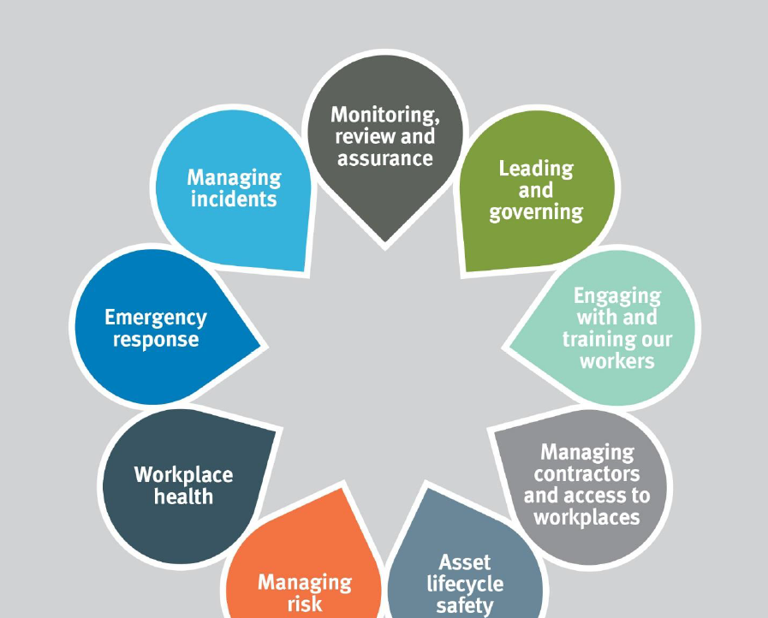
Requirements
Outline core principles and key considerations
Highlight key safety and operability requirements
Define key functional outcomes requirement for a safe environment
Develop reference implementations
Design
Identify hazards
Eliminate hazards where practicable
Identify control measures for residual risk
Hand over control information to operations
Convey lessons learnt
Safety in Design
H&S Tool Kit
Engineering Standards Framework
Safety in Facility Design
Operation
Ensure the asset is operated with its safe design envelope
Monitor the performance standards of risk controls throughout the life the asset
Provide operational feedback into the design process
Apply change management to improve operation
Engineering
Robust standards
Protocol for deviation form standards
Engineering knowledge supported by best practice and guidance documents

Slide 4
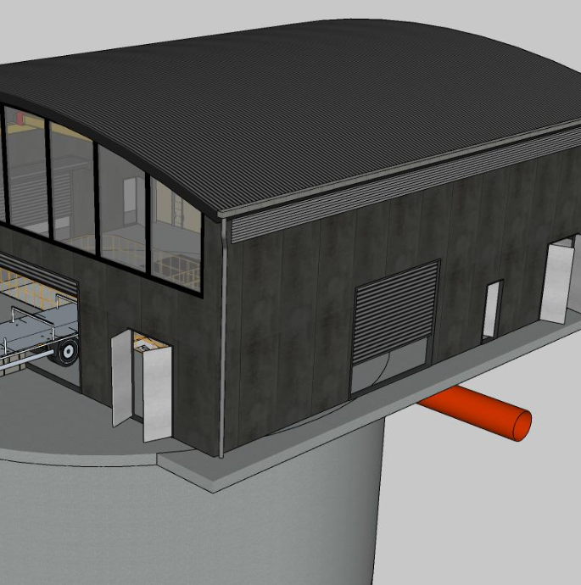
Wastewater Pump Station Design 2018 Update
Design Opportunities
Set a leading an initiative for excellence in Safety in Design and Facility Design.
A design approach that involved visiting existing sites and undertaking simple 3D modelling early. This shaped the repeatable elements, identified leading site constraints and enabled a lead in safety in design with operator engagement.
The design focus of the facility update :
Proven self-cleaning sump hydraulics with safe confined space access
Improved dry-well layout
Repeatable lifting and odour treatment design
A separated switchroom layout with a clear operator line of site and VSD positioned to directly discharges waste heat.

Slide 5
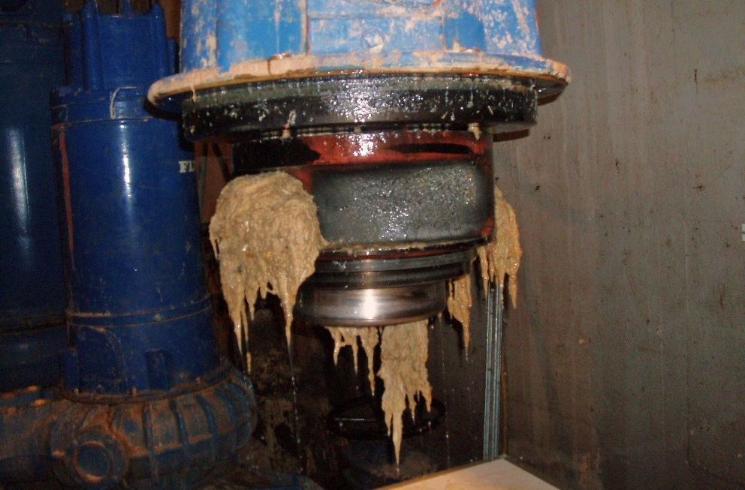
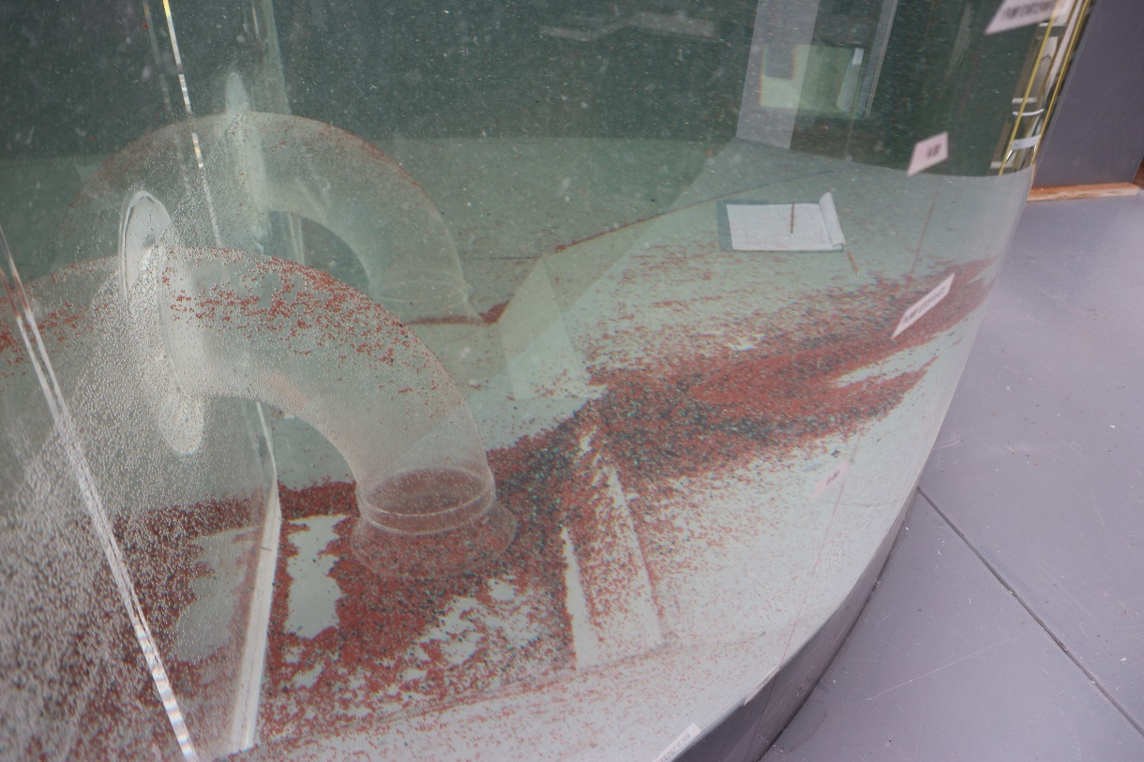
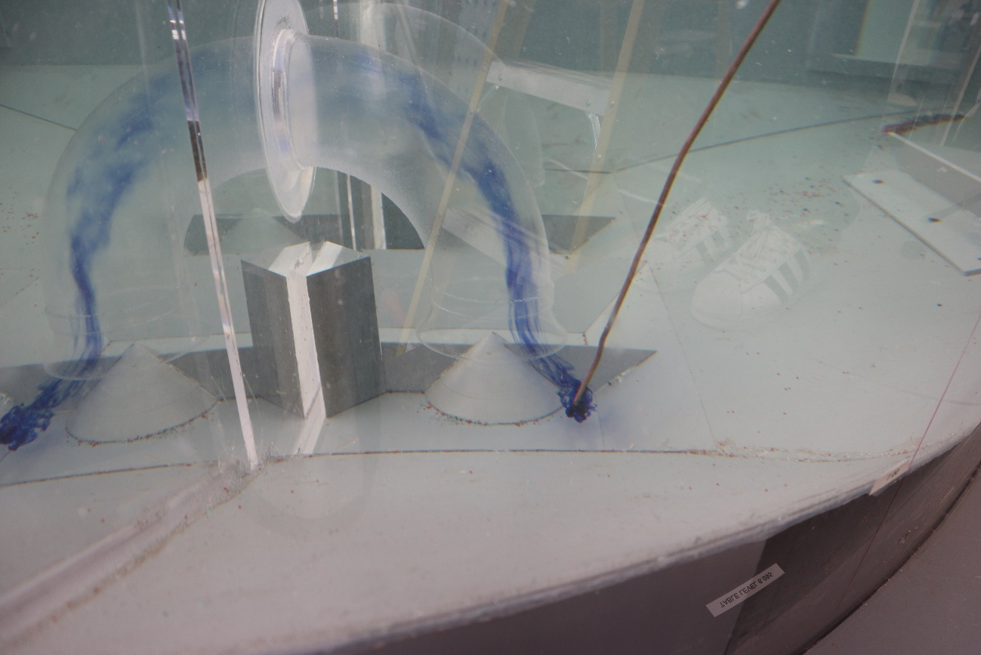
Wet-well
Poor sump design has considerable implications
The process included proving the hydraulic performance to ensure solids movement, avoid air entrainment and mitigate vortices or pre-swirl.
Review of the sump cleaning and method of access
Initial Design Final Design

Slide 6
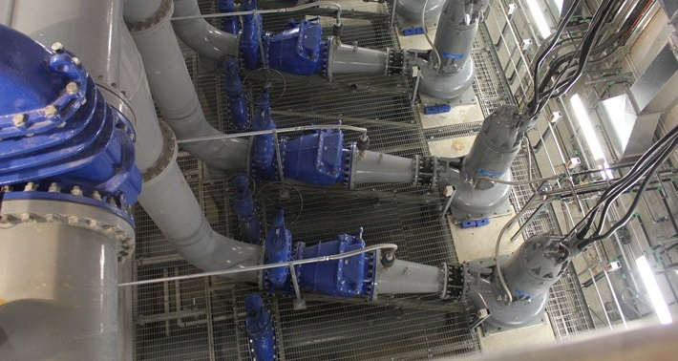
Dry-well: Long suction lines require an additional flooring system and pipework.

Slide 7
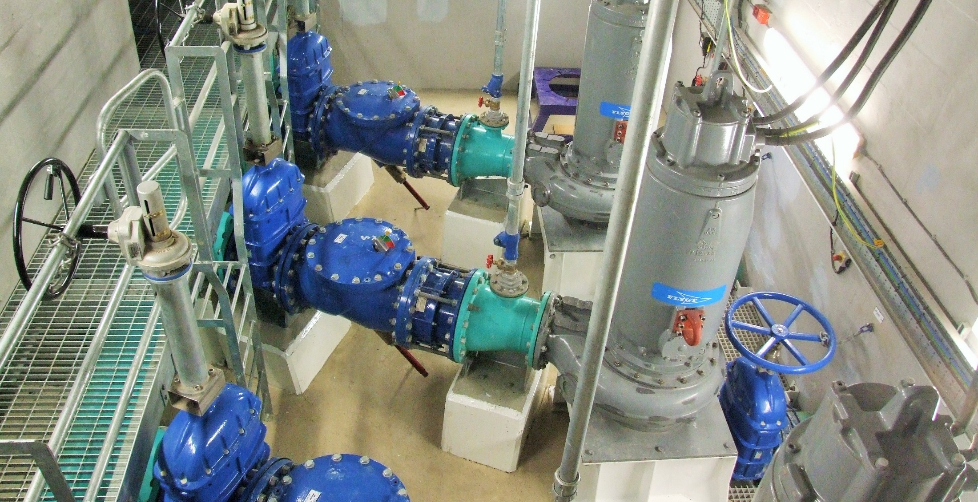
Dry-well: Short suction lines offer a simplified dry-well layout

Slide 8
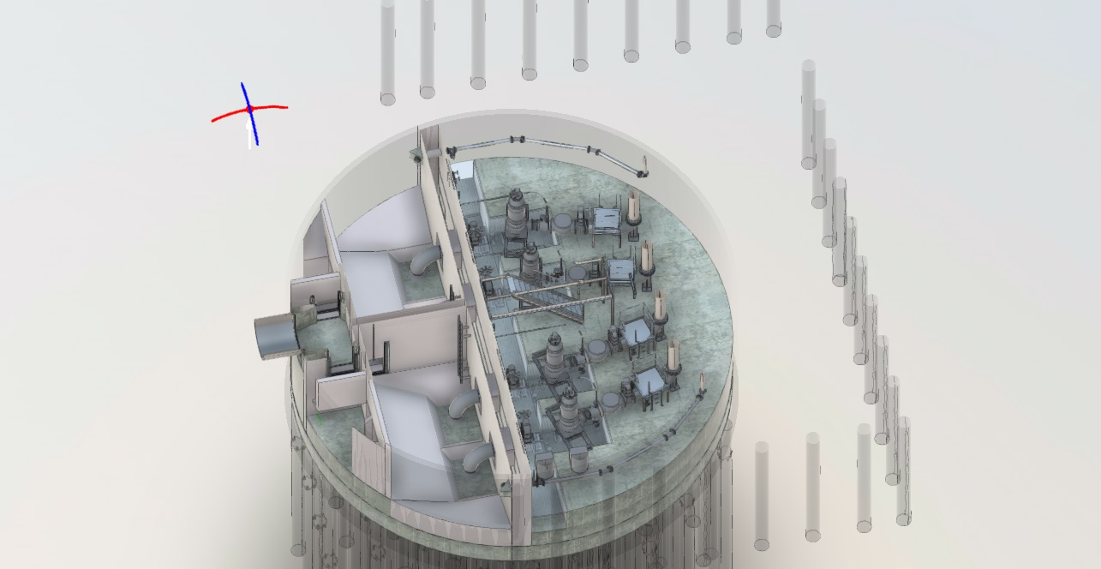
Wairau WWTP: Wet-well / Dry-well

Slide 9
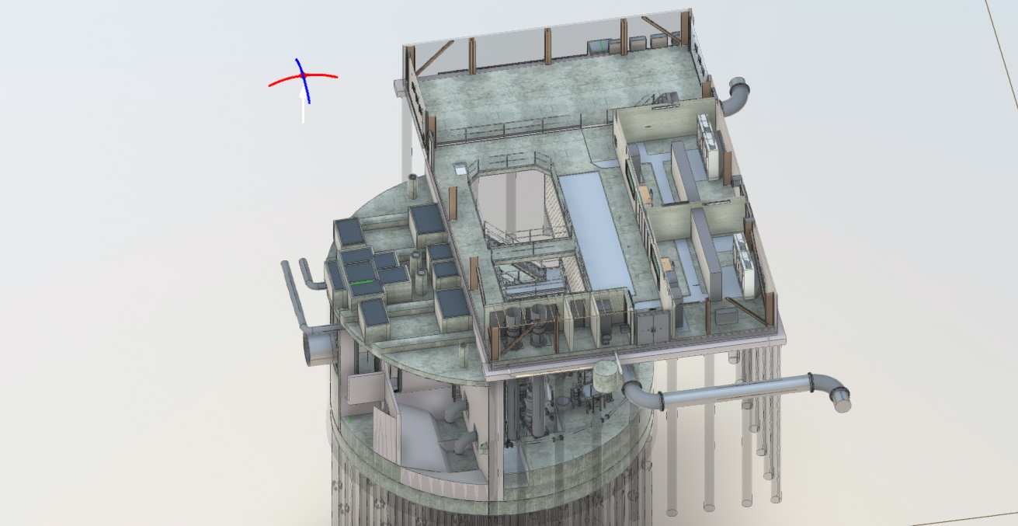
Wairau WWTP: Ground floor

Slide 10
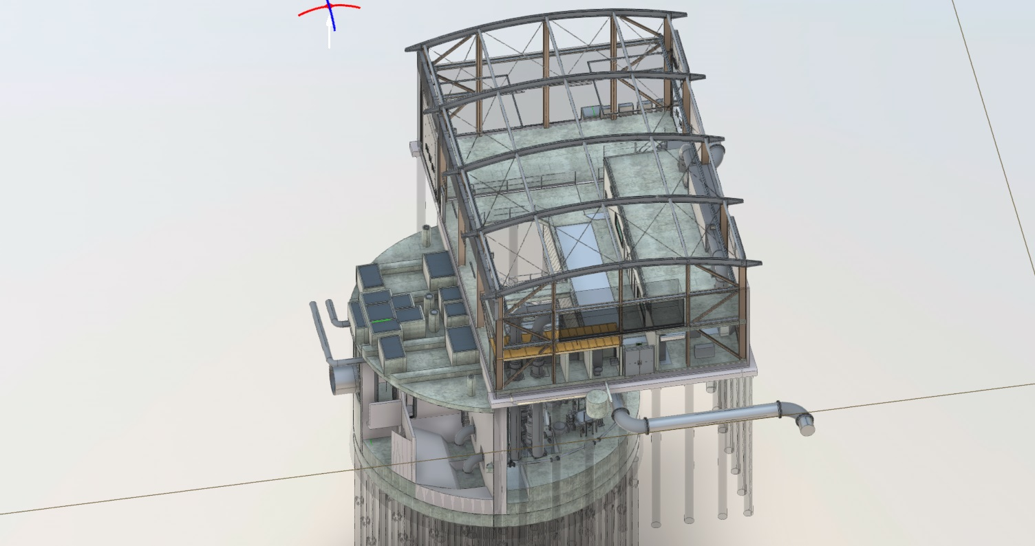
Wairau WWTP: Isometric

Slide 11
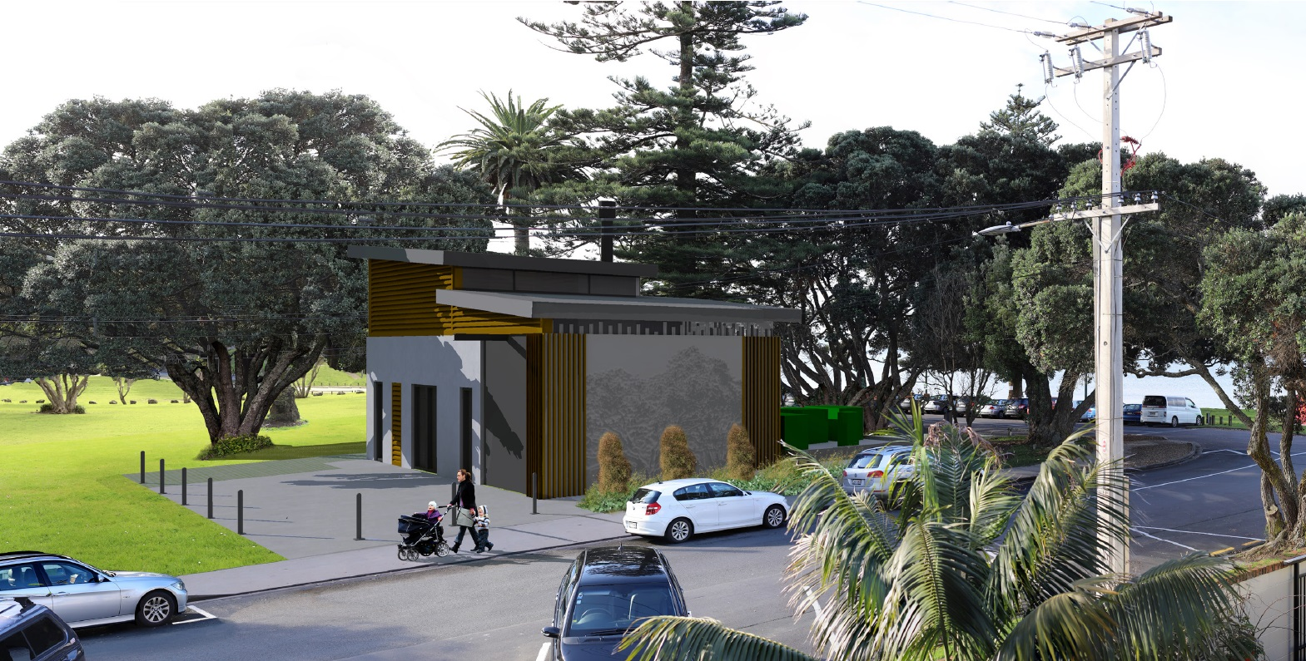
Mairangi Bay WWTP: Beach front location challenge

Slide 12
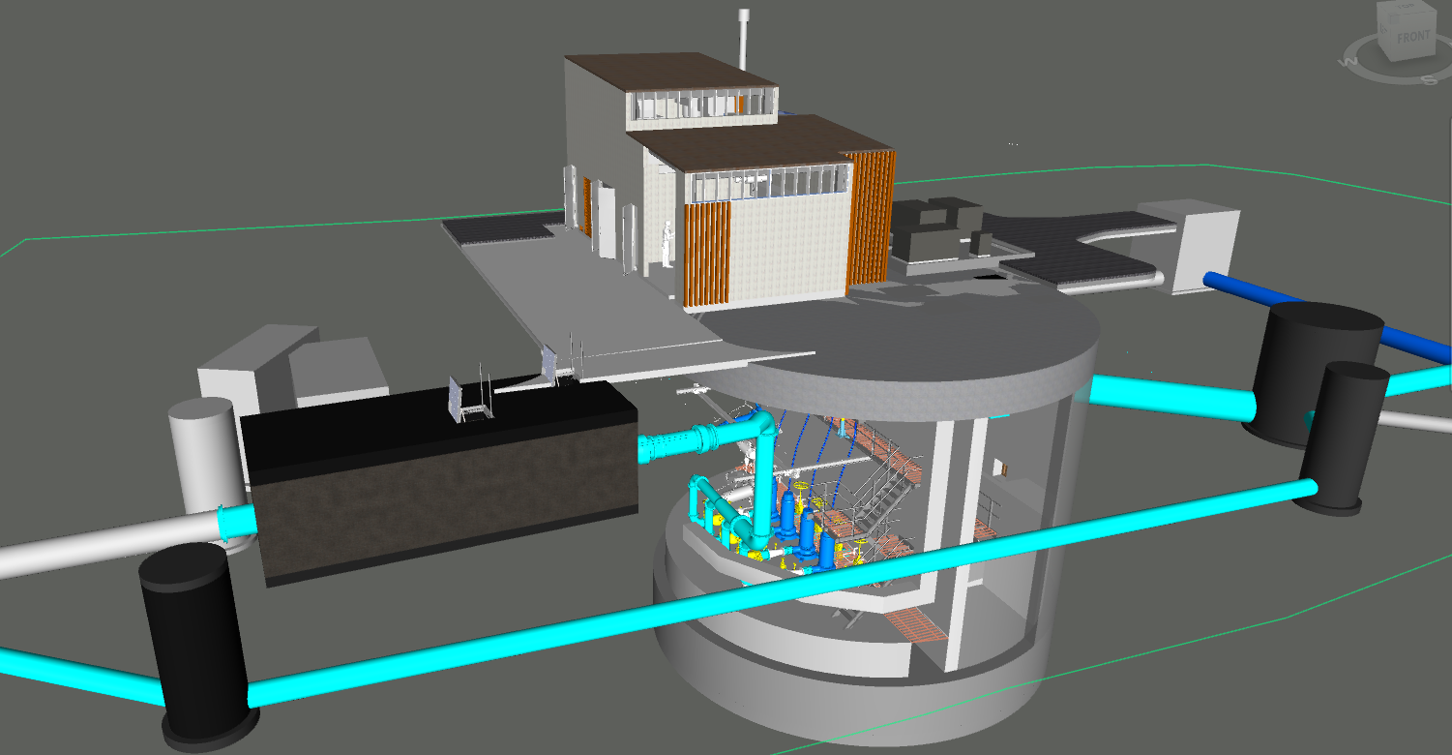
Mairangi Bay WWTP: Isometric

Slide 13
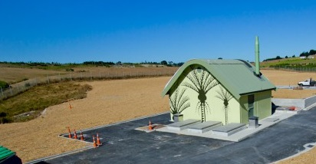
Up Next: Wet-well Facility Design
To complete the full spectrum of pump station facility design, a parallel process is planned for wet-well stations and a review is underway for package pump stations.
A Watercare Safety in Facility Design requirements guide for wastewater pump stations.

Slide 14
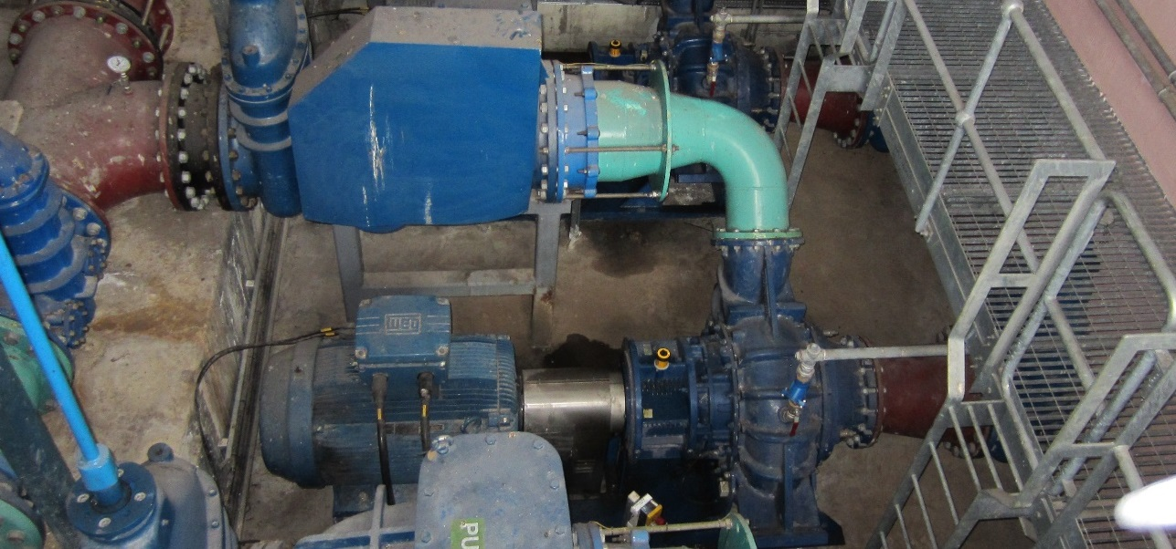
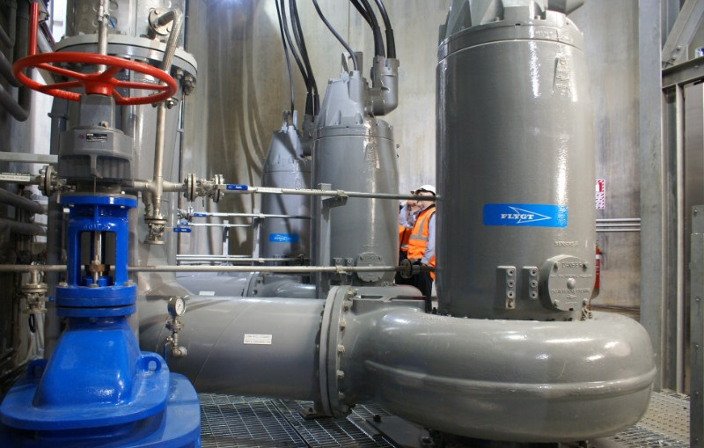
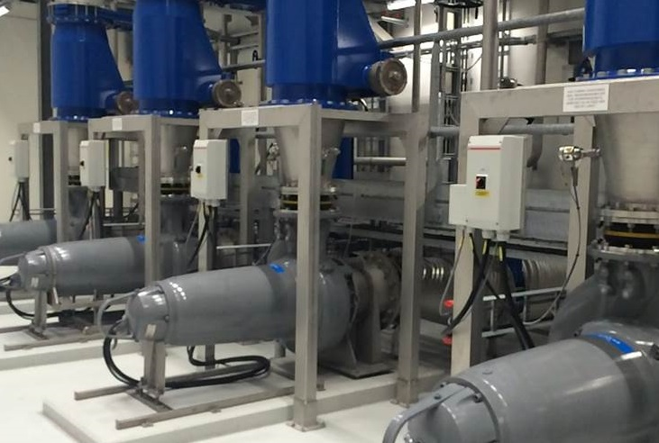
Future Possibilities
A 3D model share to improve entrusted works outcomes
Dry-well Horizontal pump mounting: Reviewed but needs lifting refinements prior to being adopted.
Vertical
Horizontal

Slide 15
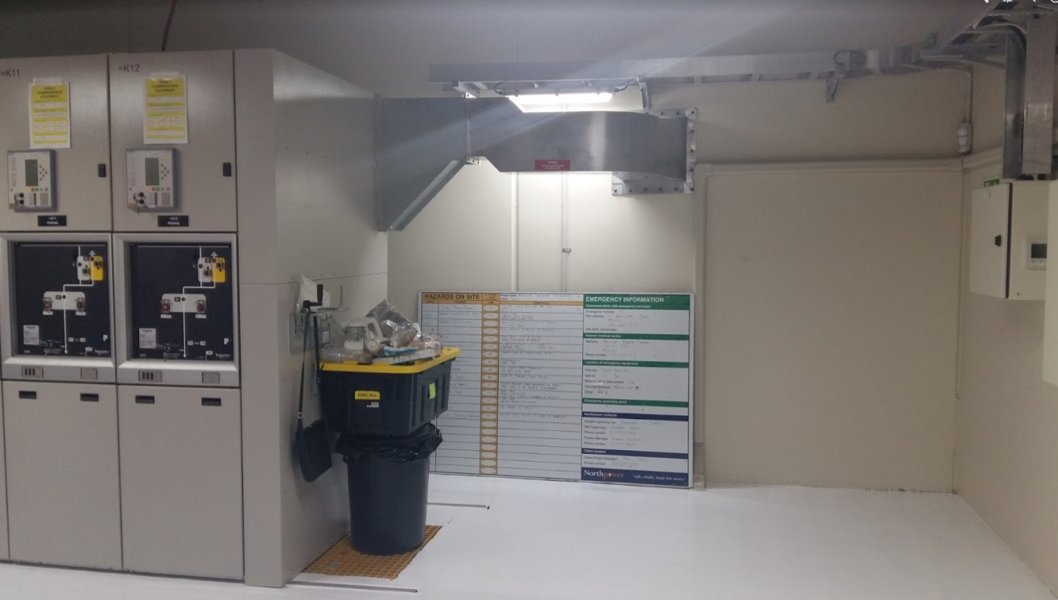
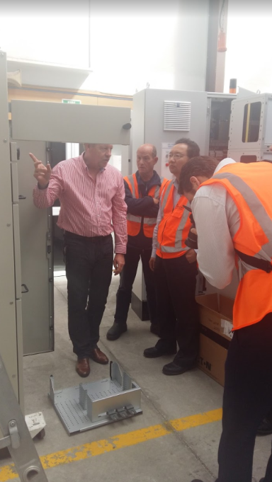
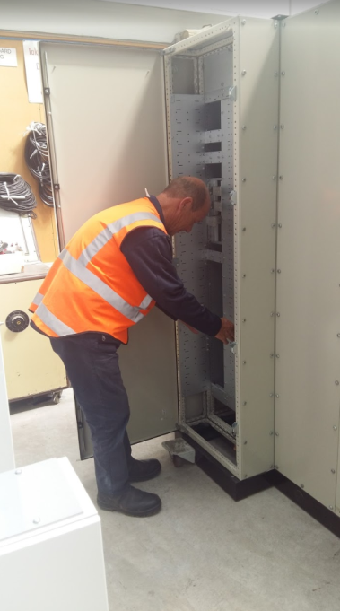
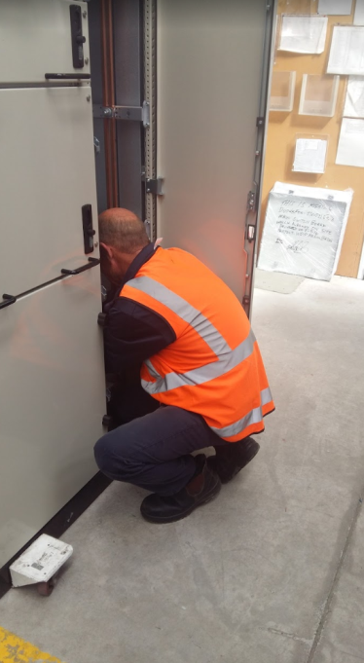
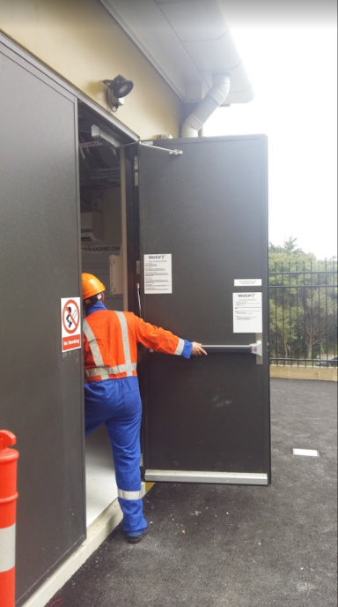
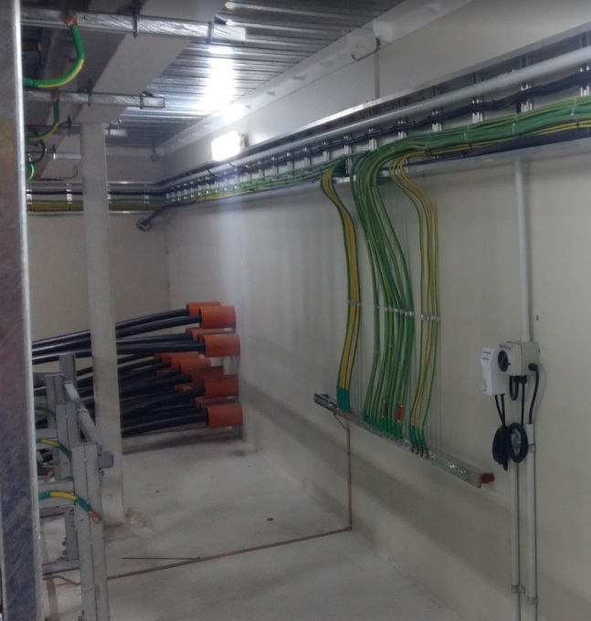
Switchroom Design 2018 Update
A design approach that involved visiting existing Watercare, Vector sites and workshops early in the design. This identified key hazards regarding the equipment installation, access and maintenance.
The design focus of the facility update :
Safe Installing and bus-bar cleaning
Cable layout and access details
Defining common ventilation, lighting and earthling details

Slide 16
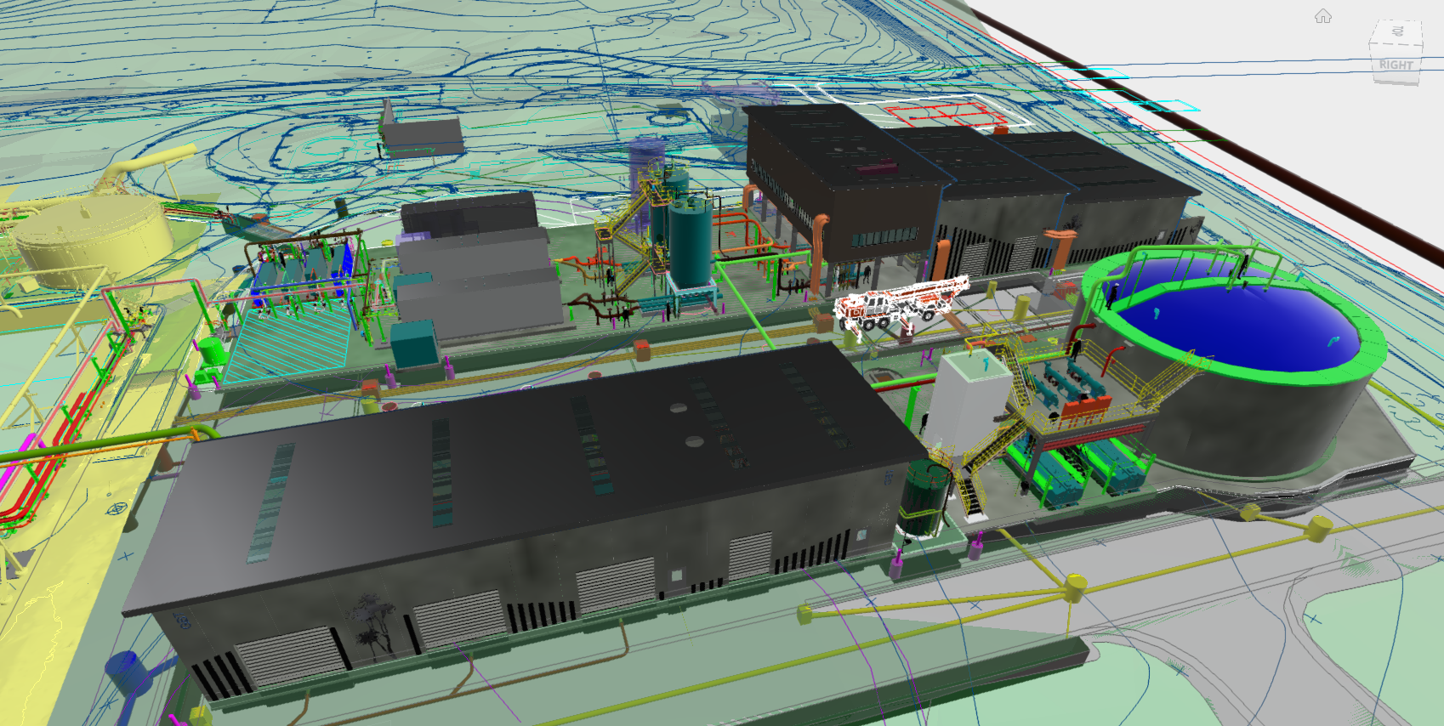
Rosedale WWTP Solids Stream Upgrade
Facility highlights:
Chemical containment
Standardised switchroom layout

Slide 17
